Slide 1











{Key : Value , Key : Value, Key : Value ,….}
1

Slide 2





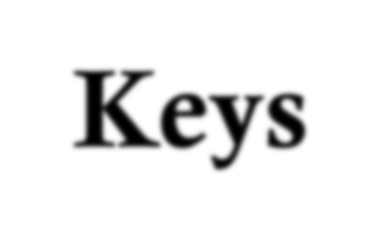











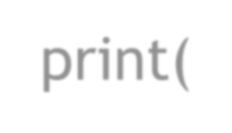




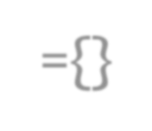


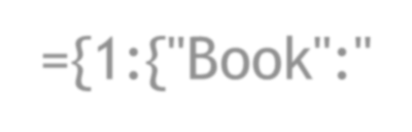

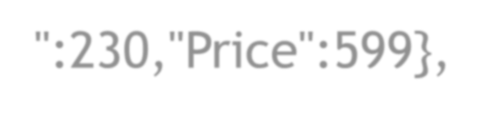

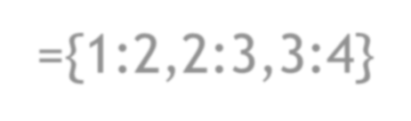
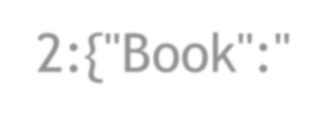

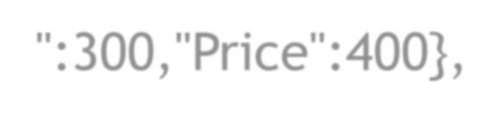
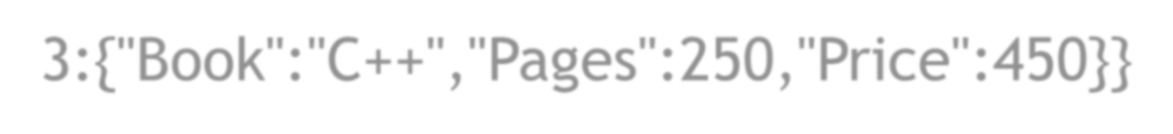


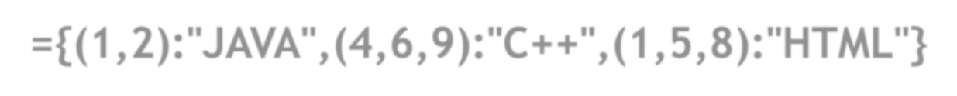
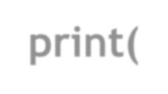

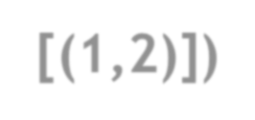
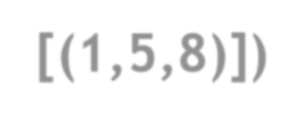
Keys VALUE
DIC_VN= {Key : Value , Key : Value, Key : Value ,….}
TUPLE
NUMBER , STRING, FLOAT, TUPLE, LIST, DICTIONARY
Dic={"BOOKS":["JAVA","C++","HTML"],"COST":(230,450,150)}
print(Dic)
Dic={1:{"Book":"Python","Pages":230,"Price":599},
2:{"Book":"JAVA","Pages":300,"Price":400},
3:{"Book":"C++","Pages":250,"Price":450}}
Dic={}
print(Dic) Dic={1:2,2:3,3:4}
print(Dic)
Dic={1:"JAVA",2:"C++",3:"HTML"}
print(Dic)
print(Dic)
Dic={(1,2):"JAVA",(4,6,9):"C++",(1,5,8):"HTML"}
print(Dic)
print(Dic[(1,2)])
print(Dic[(1,5,8)])
Dic={1:"JAVA",2.0:"C++",3.14:"HTML"}
print(Dic)
Dic={"BOOKS":["JAVA","C++","HTML"],"COST":(230,450,150)}
print(Dic)
2

Slide 3

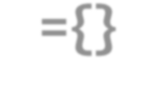
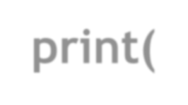




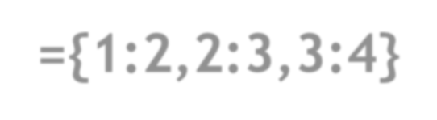
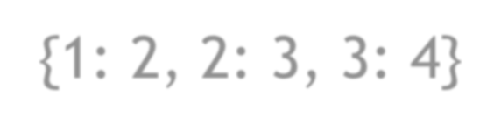






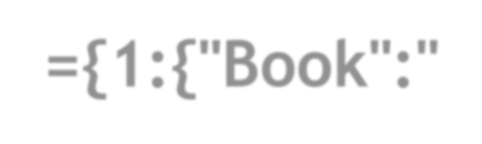

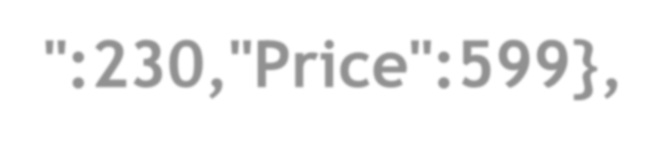
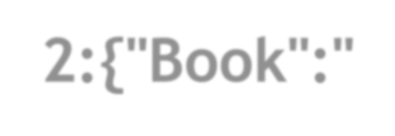

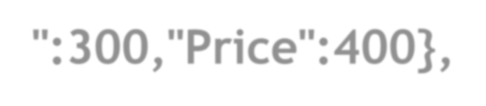

Dic={} print(Dic)
{}
Dic={1:2,2:3,3:4}
print(Dic)
{1: 2, 2: 3, 3: 4}
Dic={1:"JAVA",2:"C++",3:"HTML"}
print(Dic)
{1: 'JAVA', 2: 'C++', 3: 'HTML'}
Dic={1:"JAVA",2.0:"C++",3.14:"HTML"}
print(Dic)
{1: 'JAVA', 2.0: 'C++', 3.14: 'HTML'}
Dic={"BOOKS":["JAVA","C++","HTML"],"COST":(230,450,150)}
print(Dic)
{'BOOKS': ['JAVA', 'C++', 'HTML'], 'COST': (230, 450, 150)}
Dic={"BOOKS":["JAVA","C++","HTML"],"COST":(230,450,150)}
print(Dic) {'BOOKS': ['JAVA', 'C++', 'HTML'], 'COST': (230, 450, 150)}
Dic={1:{"Book":"Python","Pages":230,"Price":599},
2:{"Book":"JAVA","Pages":300,"Price":400},
3:{"Book":"C++","Pages":250,"Price":450}}
print(Dic)
{1: {'Book': 'Python', 'Pages': 230, 'Price': 599},
2: {'Book': 'JAVA', 'Pages': 300, 'Price': 400},
3: {'Book': 'C++', 'Pages': 250, 'Price': 450}}
3

Slide 4







#Update & Add Item
Dic={1:2,2:3,3:4}
print(Dic) {1: 2, 2: 3, 3: 4}
Dic[2]=12
print(Dic) {1: 2, 2: 12, 3: 4}
Dic[3]="Fun!"
print(Dic) {1: 2, 2: 12, 3: 'Fun!'}
Dic[4]="Joy!"
Dic={1:2,2:3,3:4}
print(Dic) {1: 2, 2: 3, 3: 4}
Dic[5]=["PYTHON","IS","EASY"]
print(Dic) {1: 2, 2: 3, 3: 4, 5: ['PYTHON', 'IS', 'EASY']}
Dic={1:2,2:3,3:4} Dic[4]=("INT","FLOAT","BOOL")
print(Dic) {1: 2, 2: 3, 3: 4, 4: ('INT', 'FLOAT', 'BOOL')}

Slide 5








dict= ([
(<key>, <value>), (<key>, <value),
# BY LIST ITEMS
Dic = dict([(1,"JAVA"), (2,"C++"), (3,"PYTHON")])
print(Dic)
Dic = dict([[1,"JAVA"], [2,"C++"], [3,"PYTHON"]])
print(Dic)
#BY LIST ITEMS keys,values=[1,2,3],["JAVA","C++","PYTHON"]
print(keys)
. . .
(<key>, <value>)
])
print(values) Dic = {}
for i in range(len(values)): print(keys[i],":",values[i]) Dic[keys[i]]=values[i]
print(Dic)
#BY TUPLE ITEMS
keys,values=(1,2,3),("JAVA","C++","PYTHON")
print(keys) print(values) Dic = {}
for i in range(len(values)): print(keys[i],":",values[i]) Dic[keys[i]]=values[i]
print(Dic)

Slide 6



dict= ([
(<key>, <value>),
(<key>, <value),
. . .
(<key>, <value>)
])
Dic = dict( Lang1='JAVA',
Lang2='PYTHON', Lang3='C++', Lang4='HTML')
print(Dic) {'Lang1': 'JAVA', 'Lang2': 'PYTHON', 'Lang3': 'C++', 'Lang4': 'HTML'}
Dic = dict( [('Lang1','JAVA'),
('Lang2','PYTHON'),
('Lang3','C++'),
('Lang4','HTML')])
print(Dic) {'Lang1': 'JAVA', 'Lang2': 'PYTHON', 'Lang3': 'C++', 'Lang4': 'HTML'}

Slide 7






Dic.get(key)
Dic.items()
Dic.keys()
Dic.values()
Dic.pop(key)
Dic.popitem()
Dic.clear()
del Dic[key] | del Dic
Dic.update(object/item/Dictionary)
Dic.setdefault(key)
Dic. fromkeys(Data List/ Sequence)

Slide 8






















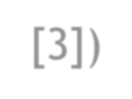





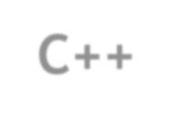



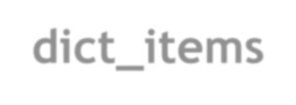




Dic={1:"JAVA",2:"C++",3:"HTML",4:"PYTHON"}
print(Dic) print(Dic[3]) ##Dic.get(key) print(Dic.get(2))
{1: 'JAVA', 2: 'C++', 3: 'HTML', 4: 'PYTHON'}
HTML
C++
##Dic.items()
print(Dic.items()) dict_items([(1, 'JAVA'), (2, 'C++'), (3, 'HTML'), (4, 'PYTHON')])
##Dic.keys()
print(Dic.keys())
dict_keys([1, 2, 3, 4])
##Dic.values()
print(Dic.values()) dict_values(['JAVA', 'C++', 'HTML', 'PYTHON'])

Slide 9






















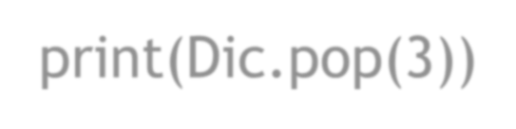






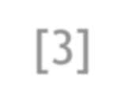










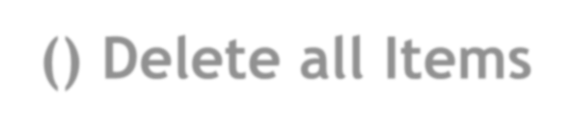




Dic={1:"JAVA",2:"C++",3:"HTML",4:"PYTHON"}
print(Dic) ##Dic.pop(key) print(Dic.pop(3)) print(Dic.pop(4)) print(Dic)
{1: 'JAVA', 2: 'C++', 3: 'HTML', 4: 'PYTHON'}
HTML PYTHON
{1: 'JAVA', 2: 'C++'}
##del Dic[key]
Dic={1:"JAVA",2:"C++",3:"HTML",4:"PYTHON"}
del Dic[3]
print(Dic) {1: 'JAVA', 2: 'C++', 4: 'PYTHON'}
del Dic[1]
print(Dic) {2: 'C++', 4: 'PYTHON'}
##del Dic delete dictionary
Dic={1:"JAVA",2:"C++",3:"HTML",4:"PYTHON"}
del Dic
print(Dic) #Error 'Dic' is not defined
##Dic.popitem() Delete last item
Dic={1:"JAVA",2:"C++",3:"HTML",4:"PYTHON"}
print(Dic.popitem()) (4, 'PYTHON')
print(Dic.popitem()) (3, 'HTML')
print(Dic) {1: 'JAVA', 2: 'C++'}
##Dic.clear() Delete all Items
Dic={1:"JAVA",2:"C++",3:"HTML",4:"PYTHON"}
Dic.clear()
print(Dic) {}
9

Slide 10
#Create List of Items,Keys and Values Dic={1:"JAVA",2:"C++",3:"HTML",4:"PYTHON"}
print(Dic) {1: 'JAVA', 2: 'C++', 3: 'HTML', 4: 'PYTHON'}
Dic1={1:2,2:3,3:4}
Dic2={1:"INT",2:"FLOAT",3:"BOOL"}
Dic1.update(Dic2)
print(Dic1) {1: 'INT', 2: 'FLOAT', 3: 'BOOL'}
print(Dic2) {1: 'INT', 2: 'FLOAT', 3: 'BOOL'}
Dic1 = {'a': 10, 'b': 20, 'c': 30}
Dic2 = {'b': 200, 'd': 400}
Dic1.update(Dic2)
print(Dic1) {'a': 10, 'b': 200, 'c': 30, 'd': 400}
print(Dic2) {'b': 200, 'd': 400}
Dic1 = {'a': 10, 'b': 20, 'c': 30}
Dic1.update([('b', 200), ('d', 400)])
print(Dic1) {'a': 10, 'b': 200, 'c': 30, 'd': 400}
Dic1 = {'a': 10, 'b': 20, 'c': 30}
Dic1.update(b=200, d=400)
print(Dic1) {'a': 10, 'b': 200, 'c': 30, 'd': 400}
List=Dic.items() print(List)
dict_items([(1, 'JAVA'),(2,'C++'), (3,'HTML'), (4,'PYTHON')])
List=Dic.keys()
print(List) dict_keys([1, 2, 3, 4]) List=Dic.values()
print(List) dict_values(['JAVA', 'C++', 'HTML', 'PYTHON']) List=[k for k in Dic.keys() if k>2]
print(List) [3, 4]
List=[k for k in Dic.keys() if k<2] print(List) [1]
List=[v for v in Dic.values() if len(v)>3] print(List) ['JAVA', 'HTML', 'PYTHON']
10

Slide 11











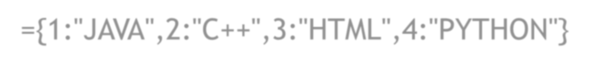




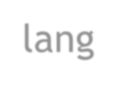
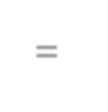


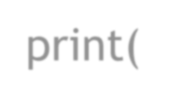



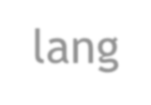




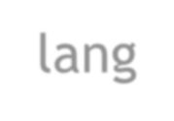

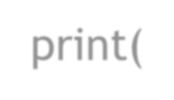




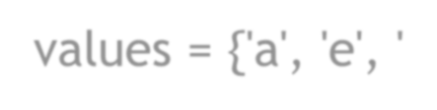

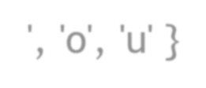




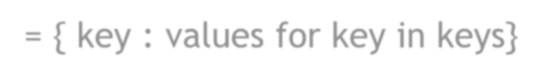

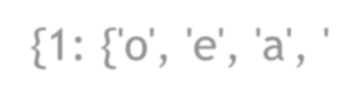

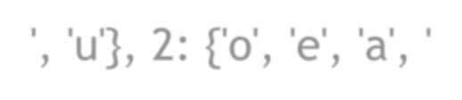

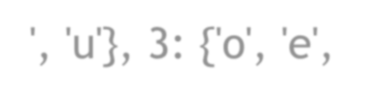

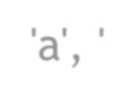
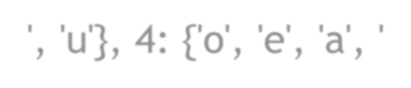
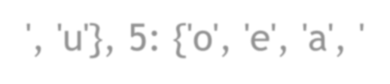
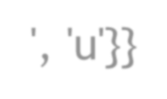
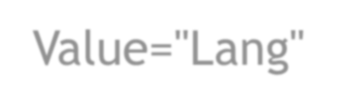

Dic={1:"JAVA",2:"C++",3:"HTML",4:"PYTHON"}
lang = Dic.setdefault(4) print(Dic)
Dic=["JAVA","C++","HTML","PYTHON"]
lang = dict.fromkeys(Dic) print(Dic)
{1: 'JAVA', 2: 'C++', 3: 'HTML', 4: 'PYTHON'}
print(lang) _{PYTHON}
lang = Dic.setdefault(5)
['JAVA', 'C++', 'HTML', 'PYTHON']
print(Dic) print(lang)
{1: 'JAVA', 2: 'C++', 3: 'HTML', 4: 'PYTHON', 5: None} ^{print(lang)}
None
{'JAVA': None, 'C++': None, 'HTML': None, 'PYTHON': None}
keys = [1,2,3,4,5]
values = {'a', 'e', 'i', 'o', 'u' }
Dic = { key : values for key in keys} print(Dic )
{1: {'o', 'e', 'a', 'i', 'u'}, 2: {'o', 'e', 'a', 'i', 'u'}, 3: {'o', 'e',
'a', 'i', 'u'}, 4: {'o', 'e', 'a', 'i', 'u'}, 5: {'o', 'e', 'a', 'i', 'u'}}
Keys=[1,2,3,4]
lang = dict.fromkeys(Keys) print(Keys) [1, 2, 3, 4]
print(lang)
{1: None, 2: None, 3: None, 4: None}
Keys=[1,2,3,4]
Value="Lang"
lang = dict.fromkeys(Keys,Value) print(Keys) [1, 2, 3, 4]
Dic = { key : value for key in keys for value in values} print(Dic ) {1: 'u', 2: 'u', 3: 'u', 4: 'u', 5: 'u'}
Dic = { key : value[:] for key in keys for value in values}
print(lang) {1: 'Lang', 2: 'Lang', 3: 'Lang', 4: 'Lang'} _{print(Dic )} {1: 'u', 2: 'u', 3: 'u', 4: 'u', 5: 'u'}
11

Slide 12






{key: value for (key, value) in zip(keys, values) }
keys = [1,2,3,4,5]
values = ["JAVA","C++","HTML","PYTHON"]
Dic={k:v for (k,v) in zip(keys, values)}
print(Dic) {1: 'JAVA', 2: 'C++', 3: 'HTML', 4: 'PYTHON'} info=[1,2,3,4,5]
Dic = {info: info**2 for info in [1,2,3,4,5]}
print(Dic) {1: 1, 2: 4, 3: 9, 4: 16, 5: 25}
Dic = {a.upper(): a.lower() for a in 'aeiou'}
print(Dic) {'A': 'a', 'E': 'e', 'I': 'i', 'O': 'o', 'U': 'u'} info=[1,2,3,4,5]
Dic={x: x**3 for x in info}
print(Dic) {1: 1, 2: 8, 3: 27, 4: 64, 5: 125} info=[1,2,3,4,5]
Dic={x: x**2 for x in info if x**2 % 2 == 0}
print(Dic) {2: 4, 4: 16}
info=[1,2,3,4,5]
Dic={x: x**2 for x in info if x**2 % 2 != 0} print(Dic) {1: 1, 3: 9, 5: 25}
12

Slide 13

D={1:"JAVA",2:"C++",3:"HTML",4:"PYTHON"}
Dic={key:value for (key,value) in D.items()}
print(Dic) {1: 'JAVA', 2: 'C++', 3: 'HTML', 4: 'PYTHON'} D={1:2,2:4,3:2,4:5}
Dic={k:v*2 for (k,v) in D.items()}
print(Dic) {1: 4, 2: 8, 3: 4, 4: 10}
D={1:2,2:4,3:2,4:5}
Dic={k*2:v for (k,v) in D.items()} print(Dic) {2: 2, 4: 4, 6: 2, 8: 5}
D={1:2,2:4,3:2,4:5}
Dic={k:v for (k,v) in D.items() if v>2} D={1:2,2:4,3:2,4:5}
{key: value for (key, value) in zip(keys, values) }
Dic={k:v for (k,v) in D.items() if v>2 if v%2 == 0}
print(Dic) {2: 4} D={1:2,2:4,3:2,4:5,5:6}
Dic= {k:v for (k,v) in D.items() if v>2 if v%2 == 0 if v%3 == 0}
print(Dic) {5: 6}
13

Slide 14


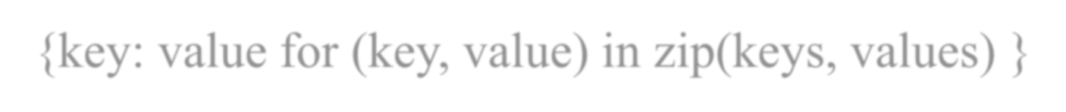
{key: value for (key, value) in zip(keys, values) }
Dic={} D={1:2,2:4,3:2,4:5,5:6}
for (k,v) in D.items():
if (v>=2 and v%2 == 0 and v%3 == 0): Dic[k] = v
print(Dic)
Dic={}
{5: 6}
D={1:2,2:4,3:2,4:5,5:6}
Dic= {k:('even %d'%v if v%2==0 else 'odd %d'%v) for (k,v) in D.items()}
print(Dic) Dic={}
{1: 'even 2', 2: 'even 4', 3: 'even 2', 4: 'odd 5', 5: 'even 6'}
Dic= {k: {v:k*v for v in range(1, 3)} for k in range(2, 5)}
print(Dic) Dic={} a=5
{2: {1: 2, 2: 4}, 3: {1: 3, 2: 6}, 4: {1: 4, 2: 8}}
Dic={k: a*k for k in range(1, 6)}
print(Dic)
{1: 5, 2: 10, 3: 15, 4: 20, 5: 25}
14

Slide 15
{key: value for (key, value) in zip(keys, values) }
Dic=dict([(i, chr(65+i)) for i in range(4)])
print(Dic)
{0: 'A', 1: 'B', 2: 'C', 3: 'D'}
Dic={i : chr(65+i) for i in range(4)}
print(Dic)
{0: 'A', 1: 'B', 2: 'C', 3: 'D'}
print({i : chr(65+i) for i in range(4)}) D={1:"JAVA",2:"C++",3:"HTML",4:"PYTHON"}
Dic=dict(map(reversed, D.items()))
print(Dic)
{'JAVA': 1, 'C++': 2, 'HTML': 3, 'PYTHON': 4}
D={1:"JAVA",2:"C++",3:"HTML",4:"PYTHON"}
Dic={value:key for (key,value) in D.items()}
print(Dic)
{'JAVA': 1, 'C++': 2, 'HTML': 3, 'PYTHON': 4}
15

Slide 16
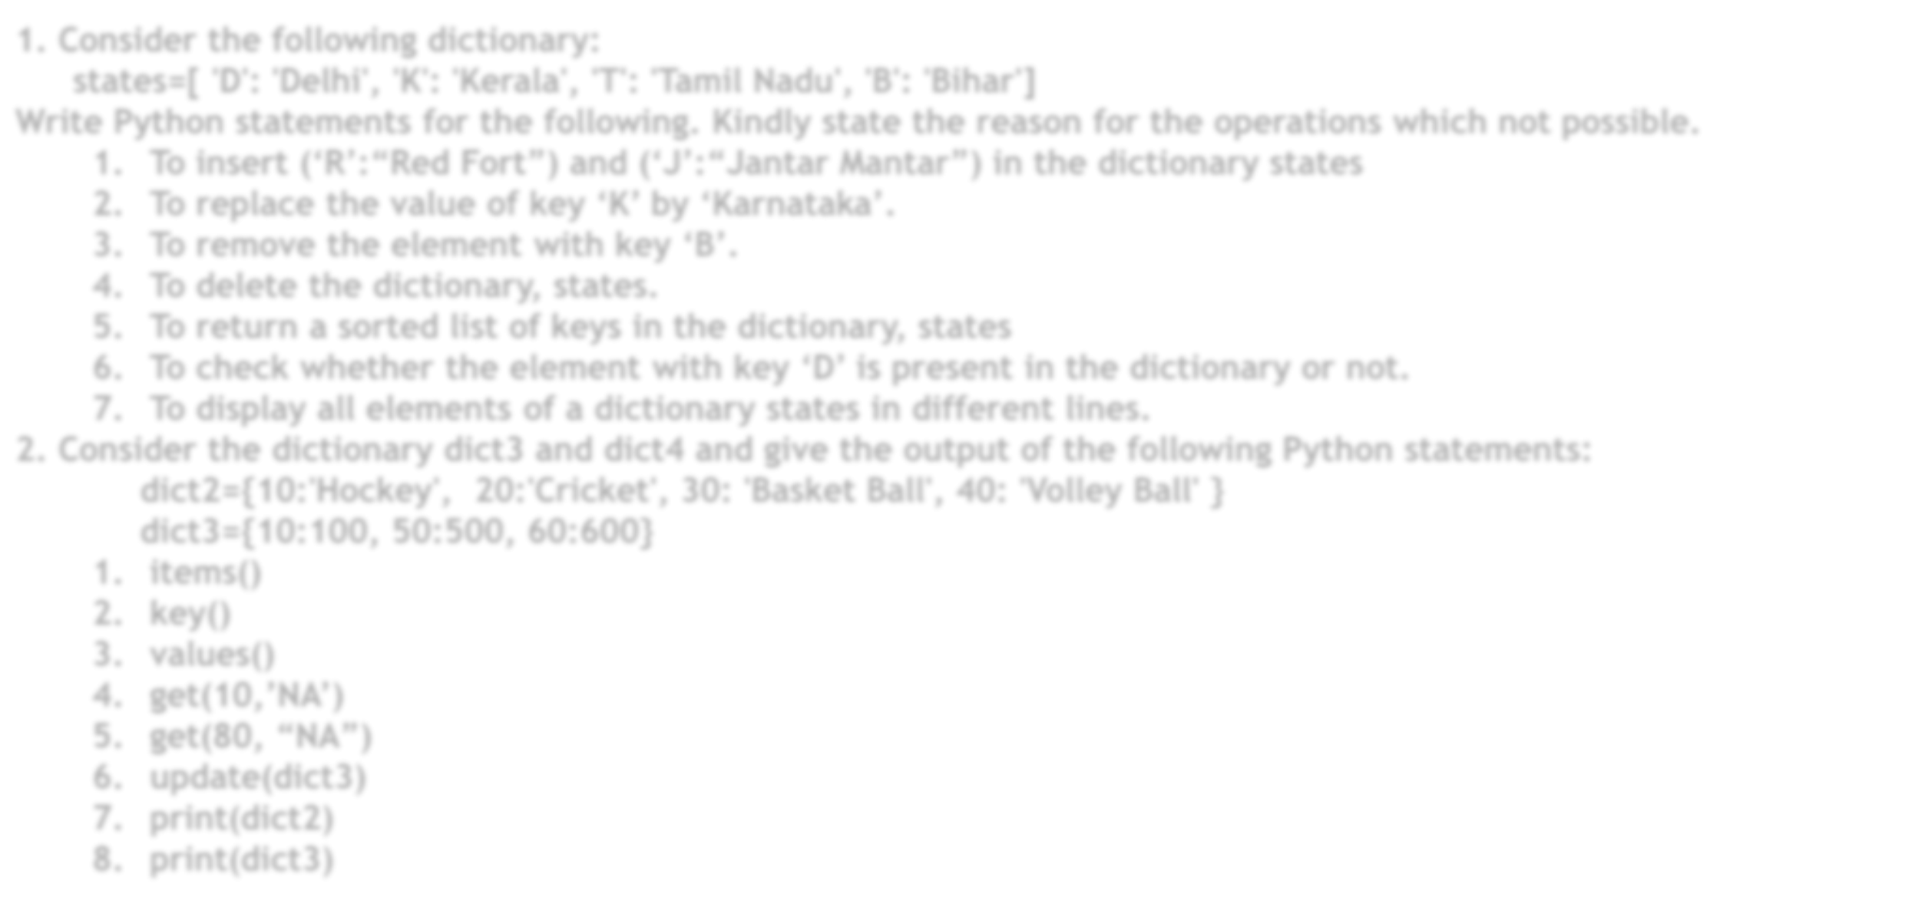




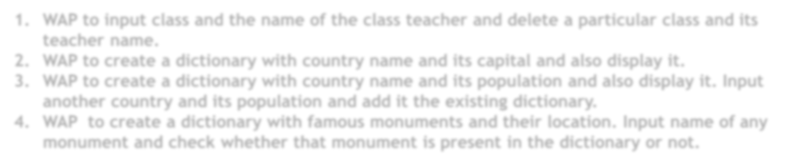

1. Consider the following dictionary:
states=[ 'D': 'Delhi', 'K': 'Kerala', 'T': 'Tamil Nadu', 'B': 'Bihar']
Write Python statements for the following. Kindly state the reason for the operations which not possible.
To insert (‘R’:“Red Fort”) and (‘J’:“Jantar Mantar”) in the dictionary states
To replace the value of key ‘K’ by ‘Karnataka’.
To remove the element with key ‘B’.
To delete the dictionary, states.
To return a sorted list of keys in the dictionary, states
To check whether the element with key ‘D’ is present in the dictionary or not.
To display all elements of a dictionary states in different lines.
DICTIONARY
2. Consider the dictionary dict3 and dict4 and give the output of the following Python statements: dict2={10:'Hockey', 20:'Cricket', 30: 'Basket Ball', 40: 'Volley Ball' }
dict3={10:100, 50:500, 60:600}
items()
key()
values()
4. get(10,’NA’)
5. get(80, “NA”)
update(dict3)
print(dict2)
print(dict3)
Programs
WAP to input class and the name of the class teacher and delete a particular class and its teacher name.
WAP to create a dictionary with country name and its capital and also display it.
WAP to create a dictionary with country name and its population and also display it. Input another country and its population and add it the existing dictionary.
WAP to create a dictionary with famous monuments and their location. Input name of any
monument and check whether that monument is present in the dictionary or not.
16

